Slide 1

A Quest Called TRIBE: Clustering Malware Families for Enhanced Triage and Analysis
MIDN 1/C:
Michael Chen (SCS), John Jenness (SCY/SCS),
Chris Kim (SDS), Justin Liaw (SCY/SCS)
Advisors:
Dr. Dane Brown (Cyber Science Department)
CDR Edgar Jatho (Computer Science Department)

Slide 2


Research Question
Can a sequence-to-sequence transformer based autoencoder create latent space representations of malware that enable effective clustering into logical groupings (TRIBEs) of malware families?
create a latent space to reduce the total number of malware families to improve triage?
Can an autoencoder be trained on a malware corpus in order to synthesize obfuscation resistant malware families?

Slide 3
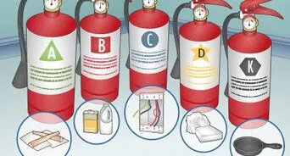
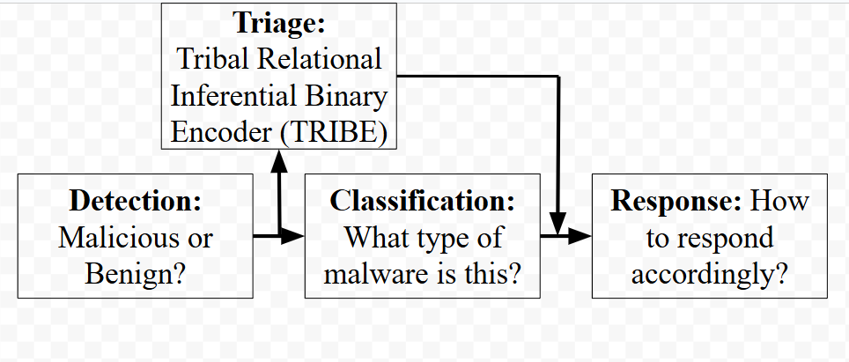

Importance
Notes:
In slide 2 I’ll talk about Trive being an overloaded term then about it being triage, do you want me to do slides 2 and 3? I can still do the analogy
For slide 5, Talk about steps 1-3 being phase 1 and phase 2 -> The actual tool development being

Slide 4
Related Works
2023 - An Auto Encoder-Decoder Approach to Classify the Bird Sounds Using Deep Learning Techniques - Vamsi, B., Mahanty, M. & Doppala, B.P [2].
2022 - A Malware Detection Approach Using Autoencoder in Deep Learning -X. Xing, X. Jin, H. Elahi, H. Jiang and G. Wang[3].
2024 - Design of an Iterative Method for Malware Detection Using Autoencoders and Hybrid Machine Learning Models - R. Beg, R. K. Pateriya and D. S. Tomar [1].
Our Contributions
Create Autoencoder
Stripped Malware Corpus
Work in the Clustering of Malware Families
Notes:
2016 - Overwhelming -> Motivation -> Reduction of Categrou
2023 - Sequence-Based analysis > Clustering?
2022 - Malware sphere, a lot of classification
MISSING DATA on LtCol Sonya ->
2024 - Like all research, we were nervous that someone was working. But to reiterate, our project is not finding (Transformer)
Leveraging Transformer

Slide 5
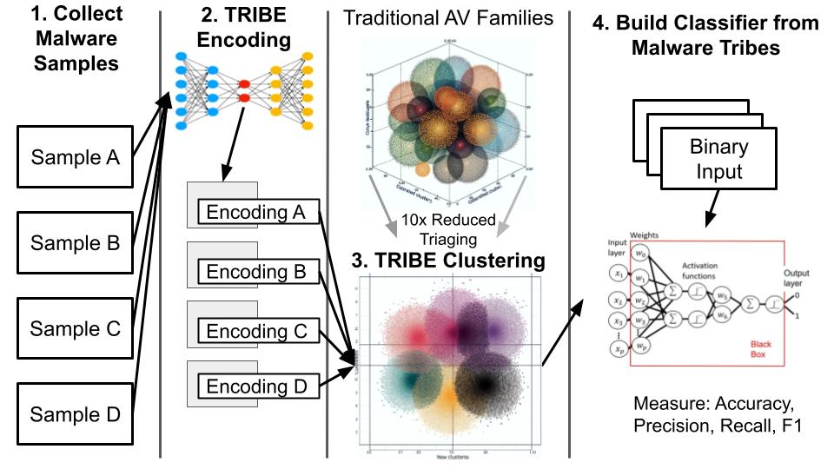
Methodology

Slide 6
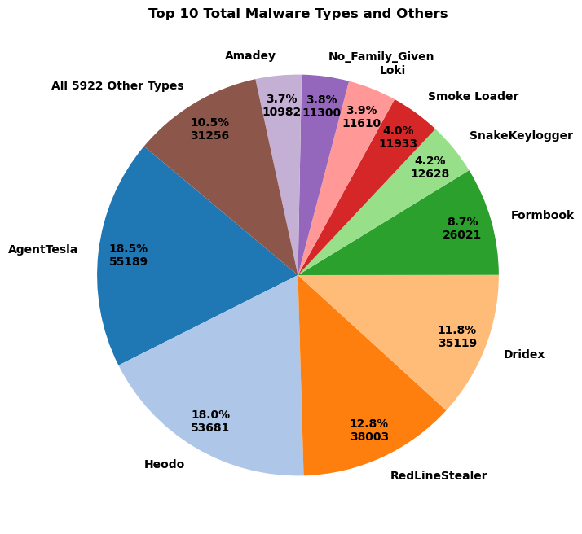
Malware Corpus
Malware Source:
MalwareBaazar from abuse.ch
Counts:
439,970 Windows malware files reduced to .text section (object code):
383,079 .exe (87%)
56,891 .dll (13%)
Size breakdown*:
1.3MB mean size
25th percentile: 236KB
50th percentile: 492KB
75th percentile: 891KB
*Due to a GPU availability of 48GB, we truncated the files to their the first 2KB

Slide 7
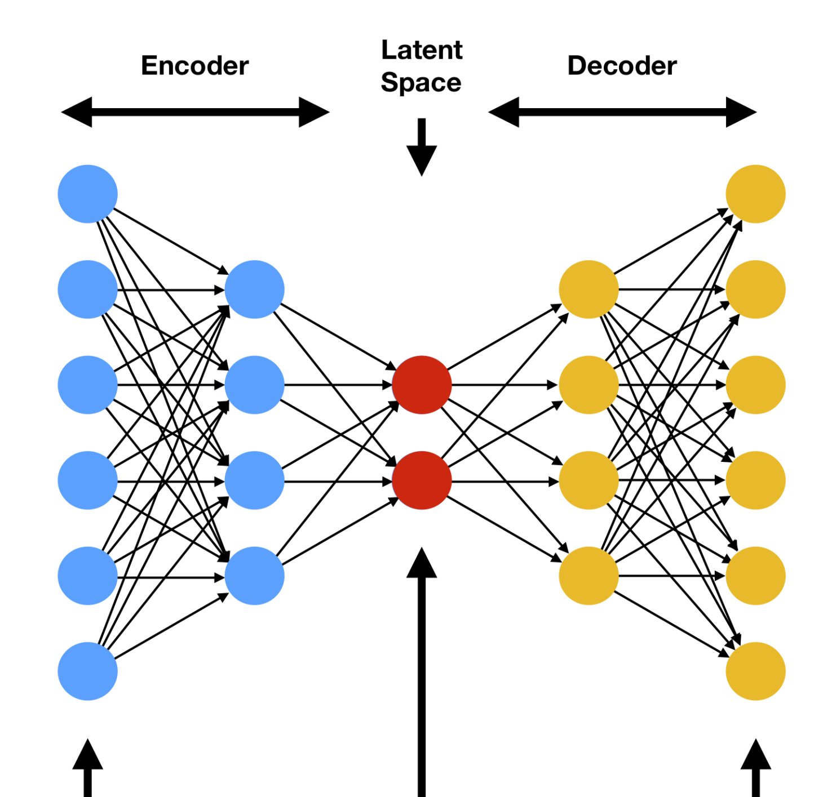
Autoencoder
Specifications
4 layers, 4 heads
Pytorch based transformer modified to use as autoencoder
sequence-to-sequence
256 vocab size (byte)
loss function: cross entropy
Current Results
Version 0:
Coding Error
Version 1:
25% Reconstruction
- 3500 File Training
Hardware Limitations:
Dedicated GPU
200KB Truncation

Slide 8
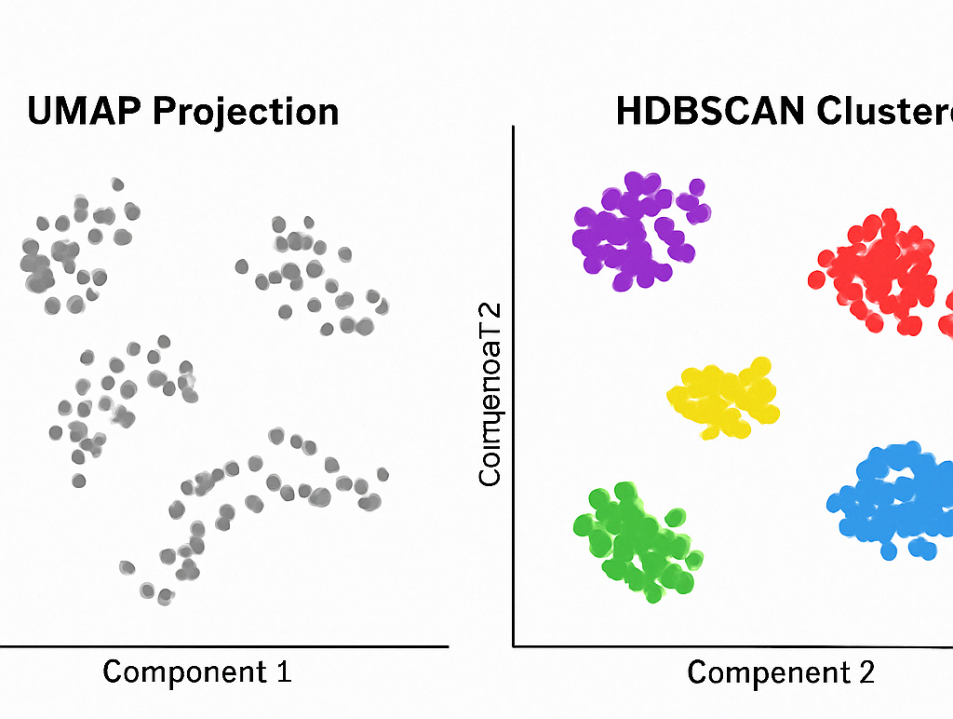
Initial Clustering
UMAP (Uniform Manifold Approximation and Projection)
Purpose: Reduces high-dimensional data to 2D or 3D for visualization or clustering
HDBSCAN (Hierarchical Density-Based Spatial Clustering)
Purpose: Identifies clusters in data with varying densities, without needing to pre-set number of clusters
How We Used Them Together:
Ran malware binaries through an autoencoder → got latent feature vectors.
Used UMAP to reduce those vectors to 2D.
Applied HDBSCAN on the 2D output to identify natural groupings.
Visualized clusters — potential malware families emerged without supervision.

Slide 9
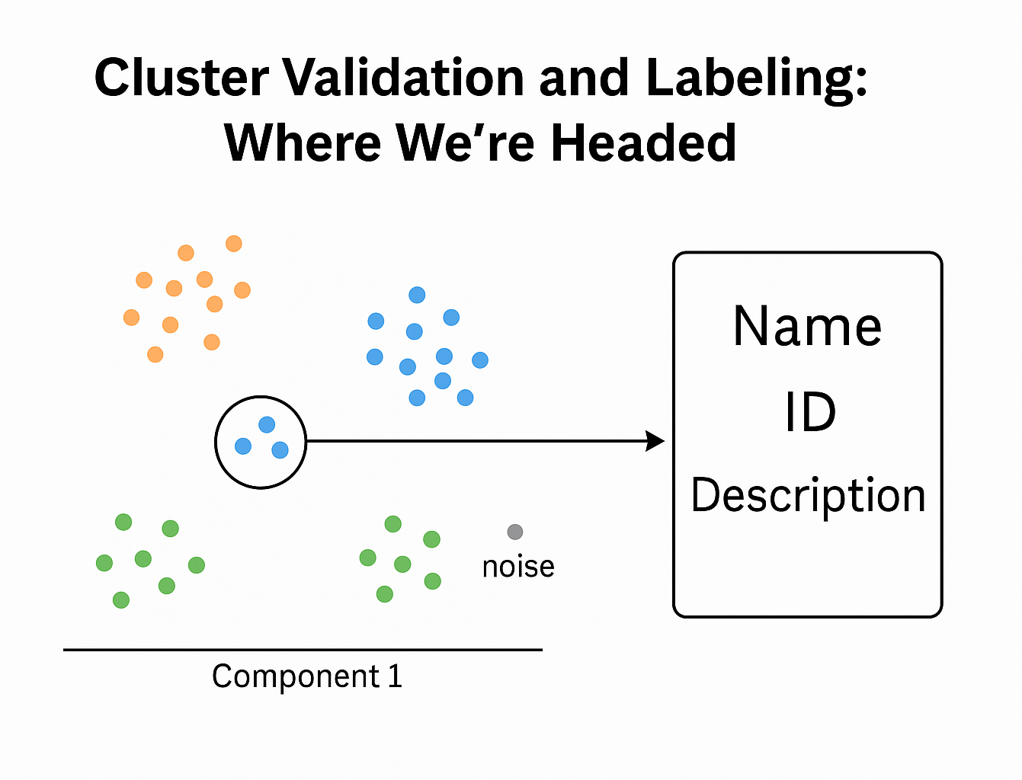
Cluster Validation & Labeling
Current State:
• HDBSCAN has grouped malware embeddings into clusters.
•Some points remain labeled as noise (likely outliers or ambiguous cases).
Next Steps:
1.Link each Malware file in a cluster to its label
2. Cross-reference log files that map original binaries to encodings
3. Build a script to validate cluster consistency
•Do samples in each cluster belong to the same malware family?
•Are noise points meaningful (e.g., polymorphic or unknown ijlijoijiojisamples)?
Why it Matters:
• Allows for interpretable clusters.
•Reduces analyst workload and improves cyber threat intelligence pipelines.

Slide 10
Conclusion/Future Work
Successfully built an autoencoder that compresses malware bytecode for clustering
Created a Malware Corpus for training and distribution
Created pipeline clustering based on latent space results
Enhancing Reconstruction Accuracy
Implementation of Gradient Boosted Decision Trees [1]
Adversarial Training [1]
TRIBE Validation & Clustering
Classifier & Productization

Slide 11


Defense and Aerospace Test and Analysis Conference

Slide 12

Questions?

Slide 13
Citation
[1] R. Beg, R. K. Pateriya and D. S. Tomar, "Design of an Iterative Method for Malware Detection Using Autoencoders and Hybrid Machine Learning Models," in IEEE Access, vol. 12, pp. 175032-175055, 2024, doi: 10.1109/ACCESS.2024.3491185.
[2] X. Xing, X. Jin, H. Elahi, H. Jiang and G. Wang, "A Malware Detection Approach Using Autoencoder in Deep Learning," in IEEE Access, vol. 10, pp. 25696-25706, 2022, doi: 10.1109/ACCESS.2022.3155695.
[3] Vamsi, B., Mahanty, M. & Doppala, B.P. An Auto Encoder-Decoder Approach to Classify the Bird Sounds Using Deep Learning Techniques. SN COMPUT. SCI. 4, 289 (2023). https://doi.org/10.1007/s42979-023-01686-4.

